Slide 1
PIRE: Taming Water in Ethiopia An Interdisciplinary Approach to Improve Human Security in a Water-Dependent Emerging Region
PIRE Water and Food Security Project Undergraduate Research informational Meeting, November 12th, 2018
Notes:
Human security is defined here in the form of water (energy) and food security.
The emerging region is Blue Nile communities in Ethiopia.
Interdisciplinary approach: the project improves understanding of the complexities of stakeholder decision-making under uncertainty and variability not readily visible through either hydro-climatic or social scientific research alone.
Involves a three-stage longitudinal design that will capture the changing links between new scientific information (tailored crop yield and hydrologic forecasts at farmer or water manager scale), political-institutional dynamics, and associated water management and agricultural activities.
The field experiments will investigate how variations of the human and natural components of the coupled system influence water and food security in these vulnerable hydro-climatic environments by contrasting the traditional understanding of “pure” science (better forecasts-improved security) against a political-institutional model that acknowledges the role of social factors.
Our work has several direct and broader impacts:
By building a better understanding of how people respond to scientific uncertainty will help us develop a practical resilience and adaptation roadmap for low income communities vulnerable to climate variability .
By integrating research with education in a study abroad framework we train a new generation of global experts with interdisciplinary understanding of water and food security
By strengthening international educational infrastructure to position our universities as global leaders in the field

Slide 2
Dr. Zoi Dokou
PIRE Project Manager
Assistant Research Professor
Department of Civil and Environmental Engineering, University of Connecticut
Email: zoi.dokou@uconn.edu
PIRE Water and Food Security Project Undergraduate Research informational Meeting, November 12th, 2018

Slide 3
PIRE Project Team
Period: April 2016 – May 2022
US Institutions: University of Connecticut (lead)
University of Wisconsin
University of Oklahoma
International Food Policy Research Institute
International Institutions: Addis Ababa University-Ethiopia (Ethiopian Institute of Water Resources)
Bahir Dar University-Ethiopia
University of Kassel-Germany
University Joseph Fourier-France
University of Reading-UK
Stakeholder Organizations: Abbay Basin Authority
(Ethiopia) Ministry of Water Irrigation and Energy
National Meteorological Agency
Notes:
The international collaboration convened for this project gathers a team of 30 faculty/researchers from 4 U.S. and 8 foreign institutions/organizations, and a cohort of currently 16 U.S. and 6 Ethiopian graduate students and a number of undergraduates who are participating through independent studies or Engineers Without Borders activities.
The added value of the international participants is major.
Ethiopian partners are critically supporting the surveys and in the near future will participate in the ethnographic studies, contribute unique hydro-climatic data and facilitate efficient implementation of our forecast-based guidance in communities and government institutions.
Our German and French partners are contributing state-of-the-art systems from hydrologic and soil moisture predictions.
Our UK partner will contribute communication tools during our near future policy and outreach activities.
Overall, with this partnership we are well-positioned to offer a new perspective on the political-institutional determinants of trust and skepticism of science in the region.

Slide 4
Motivation Help stakeholders manage climate variability to improve crop and energy production
Impacts of rainfall on Ethiopia GPD and Agri. GDP (from World Bank, 2006)
Notes:
Lack of infrastructure and capacity to adopt and respond to hydro-climatic variability introduces critical water and food security issues in sub-Sahara African communities.
Reduce those insecurities by suppling organizations and farmers valuable advance information to guide their respective water management and agriculture decisions, which translates into greater crop yields or energy production during normal years, and minimized losses during climatic extremes.

Slide 5
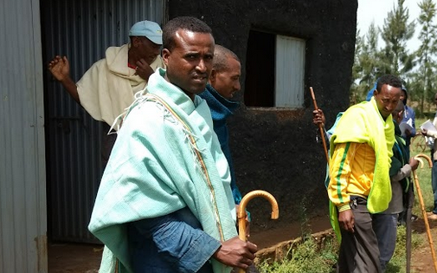
Project Aim Understand how the relationships between scientists, farmers, water managers, and other authorities influence the production, dissemination, and outcome of new scientific knowledge
Dual Objectives
Improve seasonal hydrologic and crop yield forecasts at scales relevant to farmers and water managers; and test a political-institutional model of science that challenges the assumption that innovation leads automatically to improved human security.

Slide 6
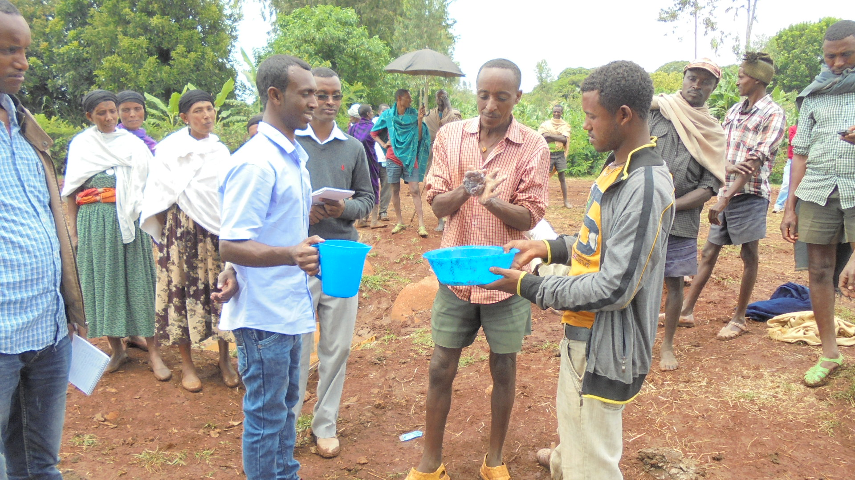
Project Aim Understand how the relationships between scientists, farmers, water managers, and other authorities influence the production, dissemination, and outcome of new scientific knowledge
Expected Outcomes
Enhance crop and energy production in normal years and minimized losses during climatic extremes;
Identify and reduce socio-political barriers to effective forecast development, dissemination and uptake
train a new generation of global experts who recognize the political-institutional and climate-ecological dimensions of complex food-energy-water problems.
EIWR students discussing water sanitation solutions with communities.

Slide 7
Research Framework
Forecasting (‘back end’)
Front end
USERS
Historical Data
In situ obs from ABA and NMA (AWS, GW, SF, HIS)
Reanalysis (35 yrs, 25 km/3-hourly)
Satellite data (P, ET, SM)
Case Studies
Irrigated Ag communities
Projected reservoir releases
Crop yields during dry season
Rain-fed Ag communities
Projected SM/P conditions
Crop yields during wet season
Water Management Authorities
Projected lake levels during wet season
Optimal reservoir management scenarios
Economic projections
WebGIS
SMS
Modeling
Hydrologic (watershed/GW)
Crop growth and yield
Economic
Social behavior - Agent Based Modeling
E-ping app
Near-Real-Time Data
Seasonal forecasts (monthly; 6-9 mon lead)
Initial soil moisture from LDAS (monthly)
Lake, GW, river levels and soil moisture (monthly);
Local data from Citizen Science Initiative;
Analogs (monthly)
Social investigations
4 agricultural communities and 2 water management authorities
Surveys
Ethnographic investigations
Simulations of farmers’ behavior and economic impacts
Dissemination
PhDs, Publications (interdisciplinary/individual components), Conference presentations
Policy outreach activities (IFPRI)
PIRE Water and Food Security Project NSF Site Visit: April 2-3, 2018

Slide 8
Fall 2017
April 2018
May 2018
Summer 2018
Project Implementation
Social Science
1) Site selection
2) Methodology of social investigations
Data Collection
1) Global data sets
2) Local agricultural data
3) In-situ hydro/meteo data
Dissemination
ePING app
Economic/Social Modeling
Preliminary results from economic model
Annual Meeting
17-18 May (DC)
First test of the models
Trip to Ethiopia (May – Aug)
Stakeholder workshop
Language training
Research studies
Engineering
1) Downscaled forecasts
2) Watershed/GW model
3) Crop yield model
Social Science
1) Conducting surveys
2) Collecting ABM social
data
Agent based model planning
Web-based “PIRE Graduate Student Brownbag Series” (Launched November 2017, twice a year throughout the project)
Language acquisition for ethnographers (Fall 2016 – Fall 2018)
PIRE Water and Food Security Project NSF Site Visit: April 2-3, 2018
PIRE Water and Food Security Project NSF Site Visit: April 2-3, 2018

Slide 9
2021
Fall 2018
Spring 2019
2019
2020
Project Implementation
In situ stakeholder and citizen science data transmitted through the e-ping app
Finalizing the forecasting system
Training ABM based on input from survey data
Preparing for the ethnographic visits
Summer school and undergraduate research in Ethiopia
Stakeholder/policy outreach workshop based on initial results
Stakeholder/policy outreach workshop
Student studies in Ethiopia
Social Investigations
testing hypotheses
Running the forecasting system: Issuing seasonal crop yield and hydrologic forecasts on monthly basis (Jan 2019 – Dec 2021)
Ethnographic field work (EFW)
Spring-Fall 2019 with 2-month follow-up visits in 2020 and 2021

Slide 10
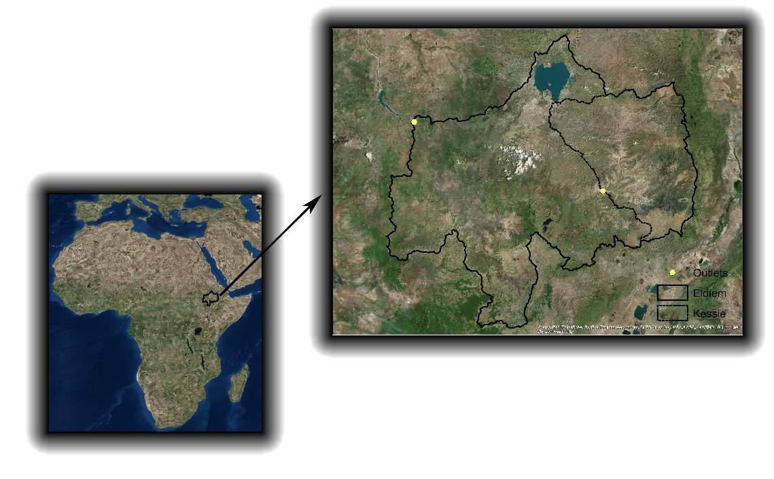
Engineering Research Highlights
Integrated Modeling Framework
Seasonal Forecasts
Watershed Modeling
Groundwater Modeling
Crop Yield Modeling
Citizen Science Initiative for Data Collection

Slide 11
Research Highlights Integration of watershed, groundwater and crop yield models
Seasonal Forecasts
Forecasting Framework
Watershed Model
Lake Levels
Groundwater Levels
Soil moisture dynamics
Recharge Rates
Soil Moisture
Streamflows
Groundwater
Model
Crop Yield
Model
Initialization
Validation
Validation
Citizen Science data

Slide 12
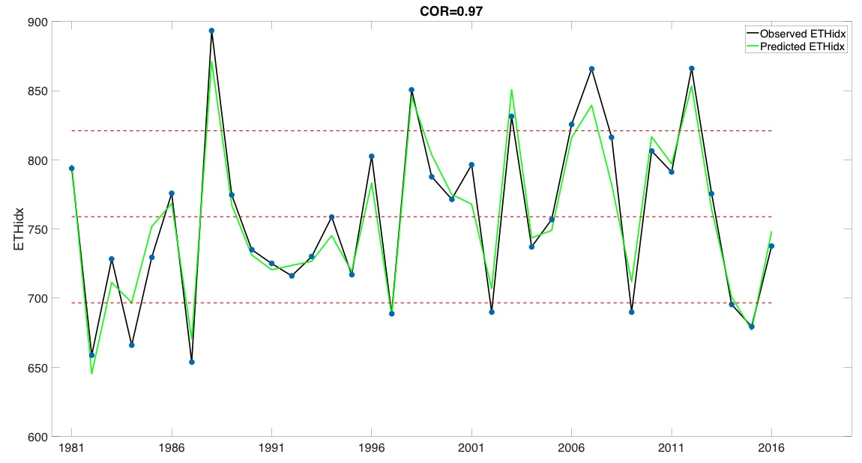
Research Highlights Development and Evaluation of a Vector Autoregression Precipitation Prediction Model for the Blue Nile Basin, Ethiopia
Objective
Develop and evaluate models to predict monthly precipitation across June-September at various scales in the Blue Nile Basin.
Notes:
Background
Ethiopia receives most of its precipitation in JJAS, which is highly correlated with simultaneous tropical SST anomalies. However, no significant correlation has been identified when SST leads precipitation. Vector autoregression (VAR) models have been shown to be successful in forecasting SSTs and precipitation in many regions.
Objective
Develop and evaluate VAR models to predict monthly precipitation across June-September at various scales in the Blue Nile Basin.
Initial Results
Variables evaluated include the first two EOF modes of precipitation, Tropical Pacific SST, Tropical Atlantic SST, Indian Ocean SST, North Pacific SST, North Atlantic SST, and global (60$°$S-60$°$N,0$°$-360$°$) Geopotential Heights at levels of 200hPa and 850hPa. EOFs are calculated for each month from May to September. The related principal components are then used as the state vectors for VAR models.

Slide 13
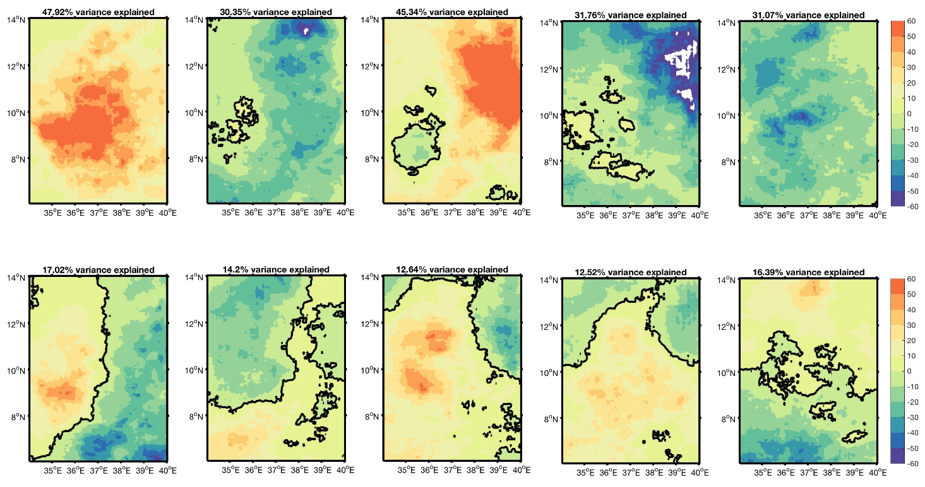
Research Highlights Development and Evaluation of a Vector Autoregression Precipitation Prediction Model for the Blue Nile Basin, Ethiopia
EOFs of May-September precipitation
Notes:
Background
Ethiopia receives most of its precipitation in JJAS, which is highly correlated with simultaneous tropical SST anomalies. However, no significant correlation has been identified when SST leads precipitation. Vector autoregression (VAR) models have been shown to be successful in forecasting SSTs and precipitation in many regions.
Objective
Develop and evaluate VAR models to predict monthly precipitation across June-September at various scales in the Blue Nile Basin.
Initial Results
Variables evaluated include the first two EOF modes of precipitation, Tropical Pacific SST, Tropical Atlantic SST, Indian Ocean SST, North Pacific SST, North Atlantic SST, and global (60$°$S-60$°$N,0$°$-360$°$) Geopotential Heights at levels of 200hPa and 850hPa. EOFs are calculated for each month from May to September. The related principal components are then used as the state vectors for VAR models.

Slide 14
Research Highlights Watershed Model
CREST-SVAS is a fully distributed hydrological model designed to simulate large watersheds at a fine spatiotemporal resolution (30 m to 1 km spatial grid resolution and hourly time steps).
Strictly couples energy and water balances.
Meteorological fields, land cover, distributed soil, vegetation and terrain properties are used as input variables.
Output of the model is streamflow in the rivers, evapotranspiration and recharge to the subsurface
Correlation Coefficient, R = 0.93
Nash-Sutcliffe Efficiency (NSCE) = 0.8305
Relative Bias = 3%
Notes:
Initial Results
This analysis shows that the WRR products which provided better representation of the streamflow, exhibited the poorest performance in ET representation. The representation of the water cycle components from different reanalysis products is affected mainly by the differences in the schemes that the various LSMs use and not by variations of precipitation forcing.

Slide 15
Research Highlights Crop Yield Model
Comparison of simulated and observed yield in recent 10 years

Slide 16
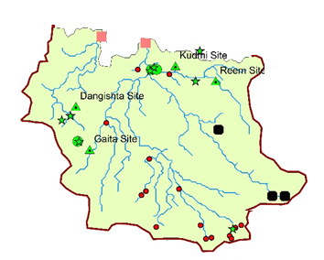
Research Highlights Groundwater Model
Local Model
Focus on 4 communities

Slide 17
Faculty and Graduate Students
Teachers and High School Students
Faculty and Graduate Students
Research Highlights Citizen Science Initiative:
promoting citizen participation in science
Who is involved from Ethiopia?
4 high schools
12 high school students
4 high school teachers
4 graduate students
Faculty Supervisors: Seifu Tilahun, Mamaru Ayalew Moges, and Muluken Azage, Bahir Dar University
What are they doing?
Collecting river stage, soil moisture and ground water level data
Planning college-ready activities
Notes:
Planning college-ready activities: e.g. bring high school students to Bahir Dar University to help analyze data, present at a workshop, and familiarize themselves with the university experience.

Slide 18
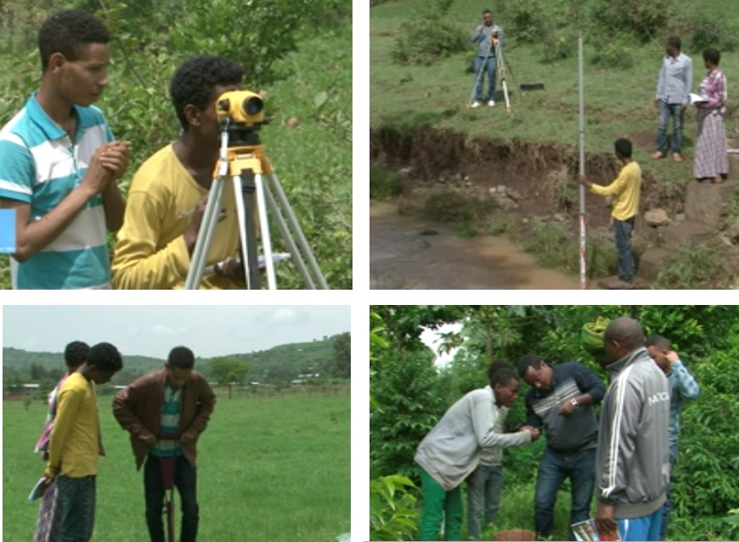
Research Highlights Citizen Science Initiative:
promoting citizen participation in science
UConn’s engagement:
Supplied the equipment: iPad mini, shallow well meter, soil moisture meter, tripod, rod, autolevel
Providing stipends for Ethiopian collaborators and supported schools
Trained students and faculty
Data will be used for a) initialization of the models for the dry season; and b) validation of the predictions made each wet season 2018 through 2022
Social scientists plan to participate and observe the project in 2019 and 2020
High school students taking river stage measurements as part of the Citizen Science Initiative in Blue Nile Basin, Ethiopia
Notes:
The engineers are currently planning to use the citizen science data for research in two ways: a) initialization of the models for the dry season; and b) validation of the predictions made during the first dry run for the wet season 2018.
Social scientists plan to participate and observe the project in 2019 to explore how high-schoolers, teachers and the scientists are involved in the transnational production of the forecast-based technology.

Slide 19
Nabil Tueme
Graduate Student
Department of Sociology, University of Connecticut
Email: nabil.tueme@uconn.edu
PIRE Water and Food Security Project Undergraduate Research informational Meeting, November 12th, 2018

Slide 20
How do the relationships between scientists, farmers, water managers and other authorities, influence the production, dissemination and outcome of new scientific knowledge?
PIRE Water and Food Security Project Undergraduate Research informational Meeting, November 12th, 2018

Slide 21
Research Plan
Conduct longitudinal research that combines physical and social scientific data to test three competing models of scientific enterprise

Slide 22
(Null) Pure Science: Communities experiencing greater hydro-agronomic vulnerability will benefit more from forecasts than other sites. The political-institutional relationships have marginal influence over outcomes (R_{O} & R_{C} > I_{O} & I_{C}).
(Hypothesis 1) Institutional Model of Science: the more institutionalized communities will implement forecasts at higher rates irrespective of hydro-agronomic variability and the quality of institutions (H > I_{O}& I_{C} > R_{O} & R_{C}).
(Hypothesis 2) Political-Institutional Model of Science: Open communities will exhibit greater benefits than closed communities irrespective of hydro-agronomic variability, even when improved forecast-based information at the farm scale, political institutional factors such as voice, trust, and fair grievance practices will prove stronger than hydro-agronomic factors (I_{O} & R_{O} > I_{C} & R_{C}).
Research Plan

Slide 23
Our Working Hypothesis: A political institution model of science
We often treat scientific investigation as apolitical or value-neutral. Yet, science is a socially situated human practice.
As such, science is inherently fallible. Thus, every scientific enterprise involves a certain degree of scientific uncertainty.
What are the best practices for communicating scientific uncertainty to non-scientists?
Political-institutional factors shape the development and transfer of scientific knowledge
What are the factors that impede the effective dissemination and uptake of new scientific knowledge?
Political-institutional theory directs our analytic attention to factors such as grievance practices, forms of voice and representation, and structural inequalities.

Slide 24
Identifying Political- institutional Constraints
Obtain a detailed understanding of decision-making contexts, interactions between forecast producers and users, and the ways that potential forecast users respond to scientific uncertainty.
Understand the social organization of water, agriculture, hydropower and science
Ethnography
Surveys
Measure the impact on decision-making across five types of communities
Compare outcomes
Identify mechanisms by which improved forecasts influence decision-making

Slide 25
The Social Organization of Water, Agriculture, Hydropower, and Science
Water becomes organized in social endeavors through:
Formal institutions like public irrigation systems and reservoir operations
Informal practices like indigenous forecasting; and
forms of governance

Slide 26
Ethnography
Deploy U.S. and Ethiopian ethnographers across four farming communities and one hydropower community to observe and talk to stakeholders as they negotiate the potential risks and rewards of new scientific knowledge.
Each team will produce observations (“field notes”) of the everyday interactions surrounding water and agricultural practices and also their community's relations with local and regional governmental sectors and other surrounding communities.
Field notes from all teams will be combined into a single qualitative database to facilitate comparative insights that distinguish between the experiences people have with scientific knowledge in open and closed systems and rain-fed and irrigated farming and hydropower communities.

Slide 27
Ethnography
Farmer A may choose to plant sorghum because he believes in our forecast-based guidance. Farmer B plants sorghum because he is following the lead of his respected neighbor, Farmer A. Farmer C plants sorghum when he really wants to plant teff because he is afraid to act in defiance of the district agronomist.
All three are “adoption” but the mechanisms by which new scientific knowledge influences the farmers are very different.
If we code an act as one of "adoption” --
We would code each act of forecast adoption as an act by a specific research participant (e.g. “Farmer A”).
We would code knowledge transfer dynamics (e.g. the participant can name the components of the forecast; the participant accessed the cellphone app prior to planting; the participant made positive remarks about the forecast to a listener; etc.)

Slide 28
Surveys
Collect primary data on forecast adoption and secondary data on crop and water management outcomes.
To measure adoption in the farming communities, we will record plating time, crop type and area, and fertilizer practices at the household level. In irrigated communities, we will also observe water allocation from the irrigation source.

Slide 29
Measuring Political-institutional Constraints
Comparing outcomes:
Evaluate relative outcomes in adoption rates and cropping practices by comparing communities
Evaluate relative outcomes in adoption rates and cropping practices by comparing between communities (control groups)
Evaluate outcomes in adoption rates and cropping practices by evaluating forecast and no-forecast (business as usual) approaches at the individual farmer and community scales.
Identifying mechanisms:
Use a multi-stage, collaborative coding process for field notes using a qualitative analysis software.
Identify and code acts of adoption, capturing nuances in the outcomes.
Theorize the mechanisms that produce outcomes by uncovering how specific barriers impede the effective dissemination and uptake of forecast-based knowledge

Slide 30
What’s Your Role?
Gender
What is the role of women in water-based decision-making?
What challenges to women face in water collection and use?
Knowledge production
How is an idea produced and accepted and why?
Politics
What political factors impact water-based decision-making?
How are people in various social locations differently impacted by policies?
Collective behavior and social movements
How do people challenge the policies that do not work for them?
Culture
How do deeply embedded values, morals, and beliefs impact water-based decision-making?

Slide 31
Spring Workshop
Reading groups
Contemporary issues on food and water security in Ethiopia
Seminars on major engineering projects in the country from a sociological standpoint
Seminars on Food Water Energy nexus
Cultural introduction
Basic Language skills

Slide 32
Ethiopia Trip
When?
June
Duration?
1 month
What will I do there?
Participate in summer school in Bahir Dar (2 weeks)
Data collection for individual research project
Data collection for PIRE project under guidance of graduate students and faculty members
Visit Addis Ababa
Are the expenses for the trip covered by the project?
Yes!
Can I still participate in the project even if not selected for the trip?
Yes!

Slide 33
Elizabeth Holzer
Associate Professor
Department of Sociology, University of Connecticut
Email: elizabeth.holzer@uconn.edu
PIRE Water and Food Security Project Undergraduate Research informational Meeting, November 12th, 2018

Slide 34
Phoebe Godfrey
Associate Professor
Department of Sociology, University of Connecticut
Email: phoebe.godfrey@uconn.edu
PIRE Water and Food Security Project Undergraduate Research informational Meeting, November 12th, 2018

Slide 35
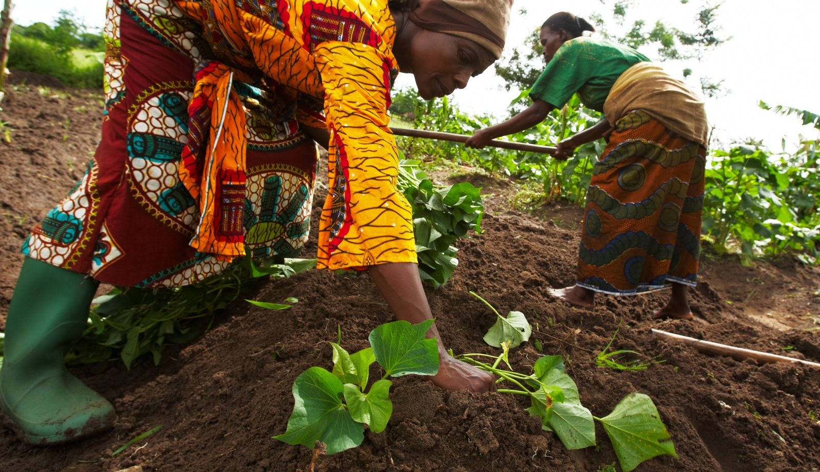
Questions?
PIRE Water and Food Security Project Undergraduate Research informational Meeting, November 12th,2018

